Slide 1
Machine Learning based Classification Model for Depression Detection
Presented by
Sakib Rokoni
ID: 23273004
1

Slide 2
Introduction
What is Depression?
Depression is a severe mental condition that may cause people to experience continuous shifts in mood and feelings of disappointment.
It is now recognized as a disease that may cause death on a global scale.
An estimated 3.8% of the worldwide population suffers from depression.
Somewhere approximately 280 million individuals suffer from depression. [3]
Existing Methods
The BDI-II was a 1996 revision of the BDI, developed in response to the American Psychiatric Association's publication of the Diagnostic and Statistical Manual of Mental Disorders
The DASS-21 is the short form of the DASS-42, a self-report scale designed to measure the negative emotional states of depression, anxiety, and stress.
PHQ-9 Patient Depression Questionnaire.

Slide 3
Introduction (Continued)
Data Collection
The aim of the research work-
To investigate depression datasets with various machine learning methods
Generating better results to detect Depression
Correlation based analysis and transformation methods to manipulate datasets
This work can detect depression at any stage of age more accurately
A total of 348 participants aged between 20 and 60 years, both males and females, employed and unemployed and with a wide range of responsibilities from household chores to professional duties who were asked to complete a questionnaire.[1]
The training, testing of the CNN model for classification uses FER2013 dataset from Kaggle with a total of 35887 images with emotion, pixel, usage[4]

Slide 4
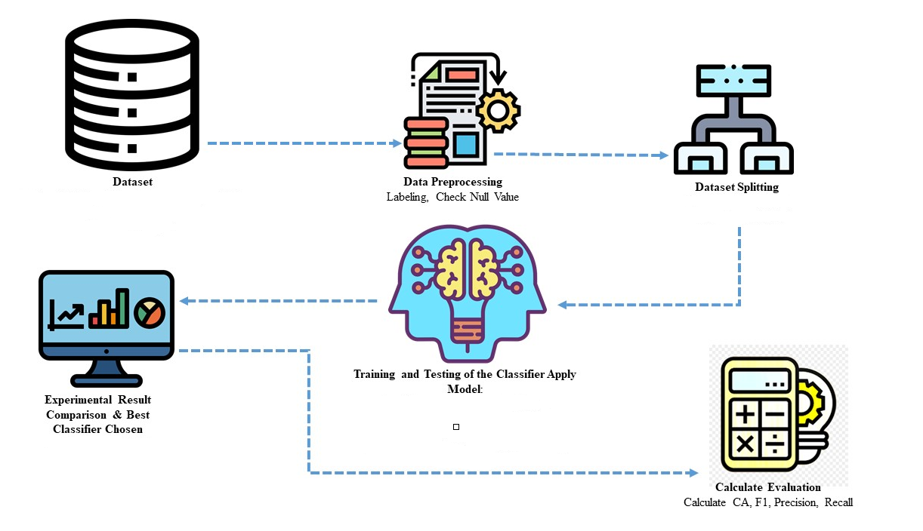
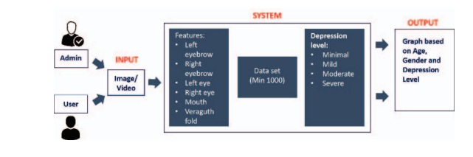
Data Preprocessing
Datasets were contained several missing values that were replaced by mean values. - Data imputation is done.
Also they investigated the correlation among individual variables and measured how strongly they are related. When one variable is highly correlated with other variables, it can be shown unstable classification result and one of them is needed to omit.

Slide 5
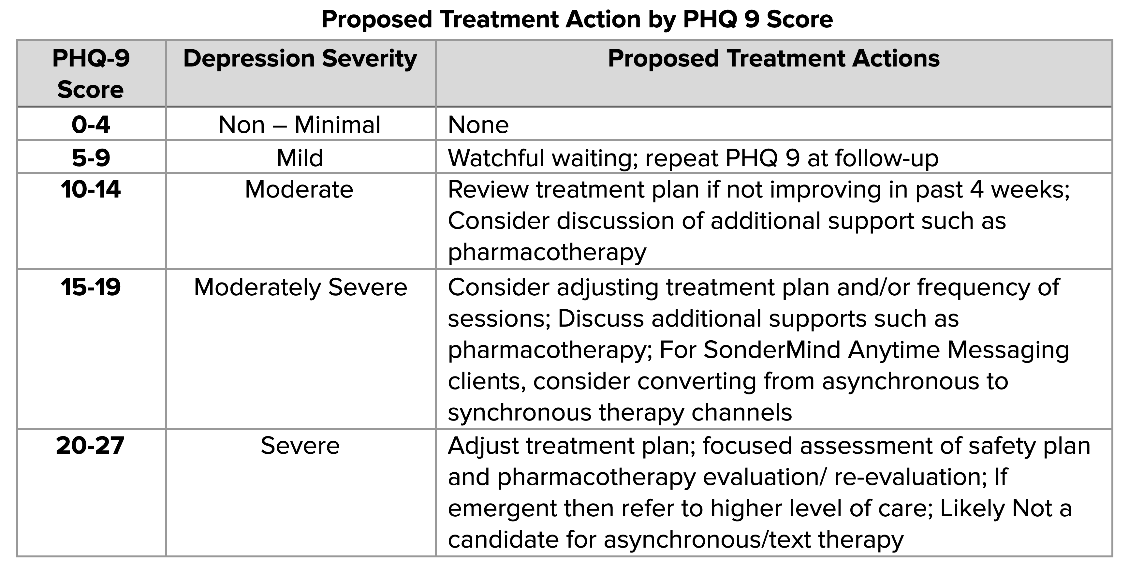
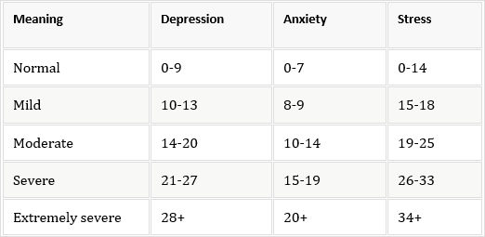
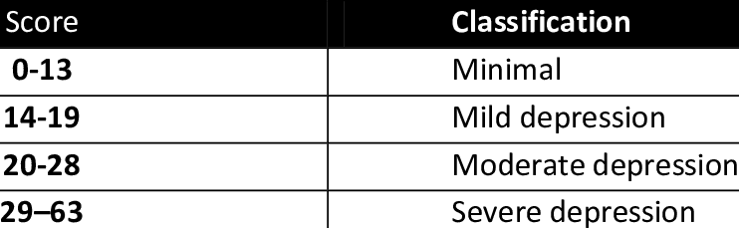
BDI- II , DASS-21 And PHQ-9 Table
Table: PHQ 9
Table: DASS - 21
Table: BDI - II

Slide 6
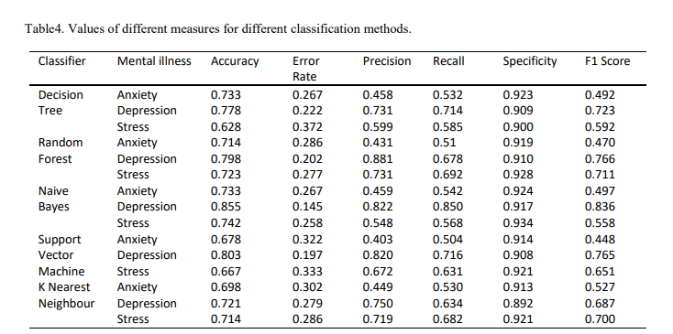
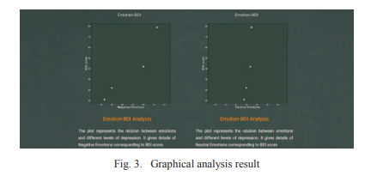
Evaluation Metrics
In the classification approach, individual values are generated like true positive (TP), true negative (TN), false positive (FP), and false negative (FN). These values are represented in a suitable structure which is called a confusion matrix.
Thus, various evaluation metrics such as accuracy, error rate, precision, recall, and specificity f1 score were used to verify the performance of these classifiers from these values.

Slide 7
Experimental Result
Five machine learning classifiers were implemented in Paper [1]
> DT- 77.7 %
> RFT - 79.8%
> NB - 85%
> SVM – 80.3%
> KNN - 72 %
In Paper [2] Convolutional Neural Network, Beck Depression Inventory-II, Correlation, and Facial Expressions were used.
Reports are generated to provide details like basic information about the user, BDI score, depression level detected, and curative measures. The accuracy of the machine learning model achieved is 66.45% using CNN.

Slide 8
Discussion
Data analytical procedures were used beforehand.
Higher performing ML model is proposed to detect Depression
Evaluation metrics (accuracy, f-measure, mean, sensitivity, specificity, fall out, and miss rate) used to compare the existing model with the previous ones.
CNN and RFT gave the best results
Reducing highly correlated variables produced better results.

Slide 9
Conclusion & Future Works
Preprocess -> Transformed format -> Classifier -> Detection of Depression
Helpful for physicians and psychiatrists in case of Behavioral Feature and Treatment Planning
Still there are no perfect screening tools for Depression Detection
In the future, more Depression datasets are required by the authors to improve the existing model.

Slide 10
Reference
Priya, Anu, Shruti Garg, and Neha Prerna Tigga. "Predicting anxiety, depression and stress in modern life using machine learning algorithms." Procedia Computer Science 167 (2020): 1258-1267.
Mulay, Akshada, Anagha Dhekne, Rasi Wani, Shivani Kadam, Pranjali Deshpande, and Pritish Deshpande. "Automatic depression level detection through visual input." In 2020 Fourth World Conference on Smart Trends in Systems, Security and Sustainability (WorldS4), pp. 19-22. IEEE, 2020.
Institute of Health Metrics and Evaluation. Global Health Data Exchange (GHDx).

